Slide 1
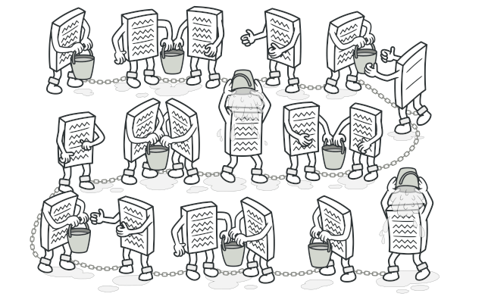
Chain of Responsibility
Gruppe 19 – pattern design
Oskar T. Hansen – au575348
Thomas Møller – au580513
Mathias Thomassen – au580521
Valdemar Tang - au586626
https://refactoring.guru/design-patterns/chain-of-responsibility

Slide 2
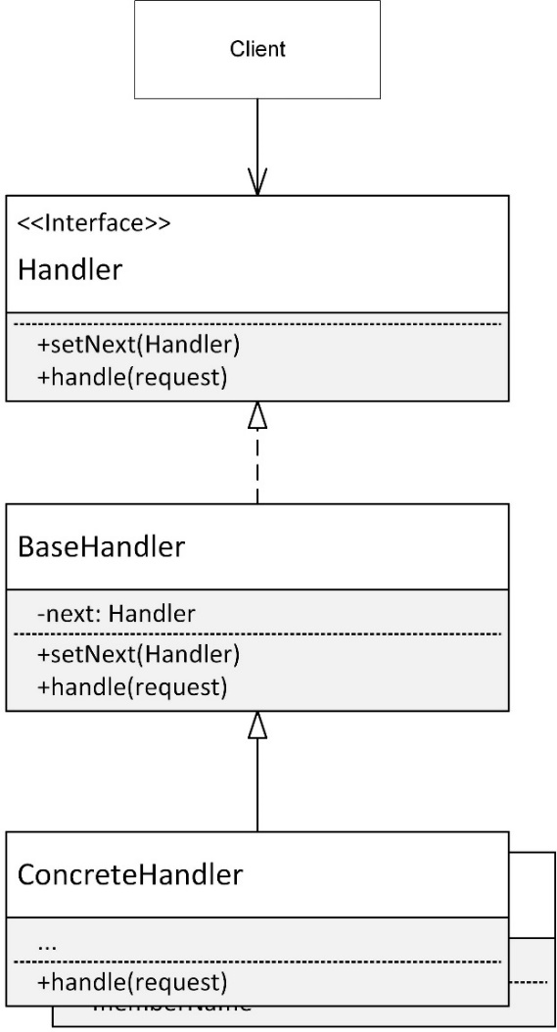

Description
Behavioral design pattern
Request til en kæde af handlers
Struktur
Fordele
Konsekvenser
https://refactoring.guru/design-patterns/chain-of-responsibility/csharp/example

Slide 3
Eksempler
Simpel tal applikation
Request = et vilkårlig tal
Handler for positive, nul og negative.
ATM system fra SWT
Ombygning af opgave til at bruge Cor.
Mediator fjernes og Cor benyttes i stedet for. Eksempel vises i demonstrations video

Slide 4
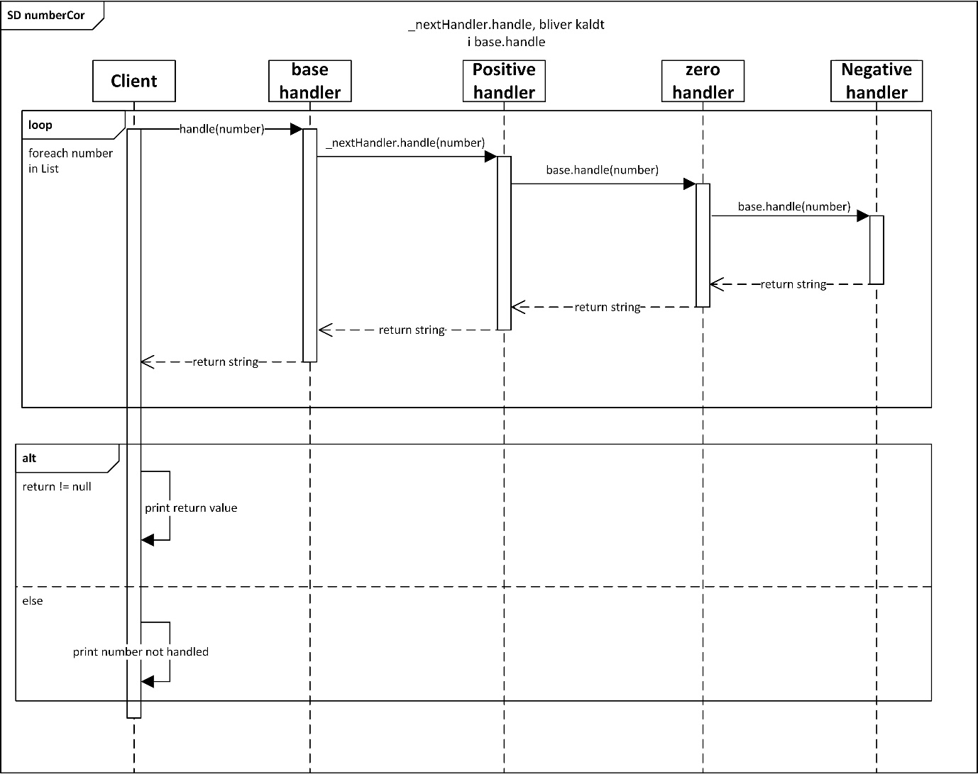
numberCor eksempel
Kode
Struktur
Overvejelser

Slide 5
Andre Patterns
SOLID-principles
SRP
OCP
Observer
Mediator

Slide 6
Billede slide 1:
https://refactoring.guru/images/patterns/content/chain-of-responsibility/chain-of-responsibility.png

